Slide 1

E-commerce Data Analysis: Strategic Insights for Business Growth
Tools used: Power BI, Excel
By ANAS ZERRABI

Slide 2
Project introduction
The primary goal of this project is to transform raw data into actionable strategic insights to help drive business growth and improve performance. This goal can be summarized in three key points:
Understand customer behaviour:
Analyse how customers interact with the online store.
Identify who your most valuable and loyal customers are using RFM analysis.
Understand purchasing patterns and identify the most popular and best-selling products.
Improve sales:
Identify factors affecting sales performance.
Discover seasonal and geographic trends that can be exploited to increase revenue.
Identify the most profitable product categories to focus marketing efforts on.
Provide actionable recommendations:
Use the analysis and findings to propose practical solutions for the company.
Provide personalized recommendations for each customer segment (such as loyalty programs for loyal customers or retargeting campaigns for potential customers).
Suggest improvements to inventory management or pricing strategies based on data analysis.
Data Source Dataset Name: Online Retail Data
Data Source Dataset Name: Online Retail Data
Source :This dataset is a public one that is often used in data analysis projects. It has records of transactions for an online store.
Timeframe: The data is from December 2009 to December 2011, which is a two-year period.
Reason: This dataset was chosen because it has a lot of information about transactions, such as product details, prices, purchase dates, and customer IDs. This makes it perfect for doing RFM analysis and learning more about how customers act

Slide 3

Strategic Execution Plan
Data Cleaning + Analysis + Visualization

Slide 4

Data cleaning methodology in Excel

Slide 5
Data Merge :
Problem: The data was split into two files (online_retail_II.xlsx - Year 2009-2010 and online_retail_II.xlsx - Year 2010-2011), and they were too large to open in Excel.
Solution: The Append Queries feature in Power Query Editor was used to merge the two files into a single table. This approach ensures efficient data processing without consuming significant resources.
Handling Missing Data:
Problem: Some rows contained missing values ​​in the Customer ID column, making it impossible to analyse the behaviour of these customers.
Solution: The rows containing null values ​​in the Customer ID column were deleted.
Creating New Columns (Feature Engineering) :
Total Price: A new column was created to calculate the total value of each purchase by multiplying Quantity by Price. This step is essential for financial analysis.
Category: A Category column was created using the Conditional Column feature based on keywords in the Description column. This step helped categorize products and facilitate sales analysis by category, rather than dealing with each product individually .

Slide 6
Sales Performance Metrics

Slide 7
Total Sales metric:
Formula: SUM(_20092011[Total_Price ])
Purpose: This metric is a key performance indicator that provides an overview of revenue. I used it to track company performance over time, identify seasonal trends, and help evaluate the success of sales strategies.
Average purchase price metric:
Formula: AVERAGE(_20092011[Total_Price ])
Purpose: This metric reflects the average value of each purchase. It helps understand whether customers tend to purchase more expensive or cheaper products and is used to monitor the validity of pricing strategies.
Frequency:
Formula : DISTINCTCOUNT(_20092011[Invoice])
Purpose: This metric doesn't count the number of rows, but rather the number of actual transactions. When compared to total sales, it helps understand whether revenue growth comes from an increase in the number of transactions or from a rise in the average invoice value.
Recency :
formula: DATEDIFF([LastdateinData],max(_20092011[InvoiceDate]), DAY)
Purpose: Calculates the number of days since each customer's last purchase. A low value on this metric indicates that the customer is currently active.
Product classification
Methodology: I used excel functions to create a new column called Category based on the keywords in the Description column using the Conditional Column tool.
Insights: This classification helped you analyse the performance of each category individually, revealing that categories like "Kitchenware" and "Gifts" are the most profitable. This type of analysis guides the company toward which products to focus on in marketing campaigns.

Slide 8
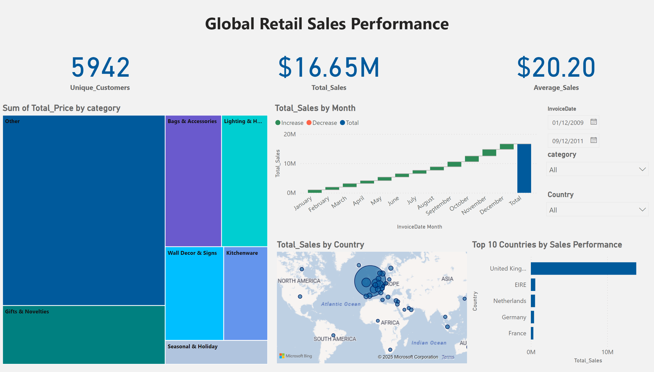
Page 2
Notes:
card
No alt text provided
card
No alt text provided
card
No alt text provided
waterfallChart
No alt text provided
treemap
No alt text provided
map
No alt text provided
Top 10 Countries by Sales Performance
No alt text provided
slicer
No alt text provided
slicer
No alt text provided
slicer
No alt text provided
textbox
No alt text provided

Slide 9
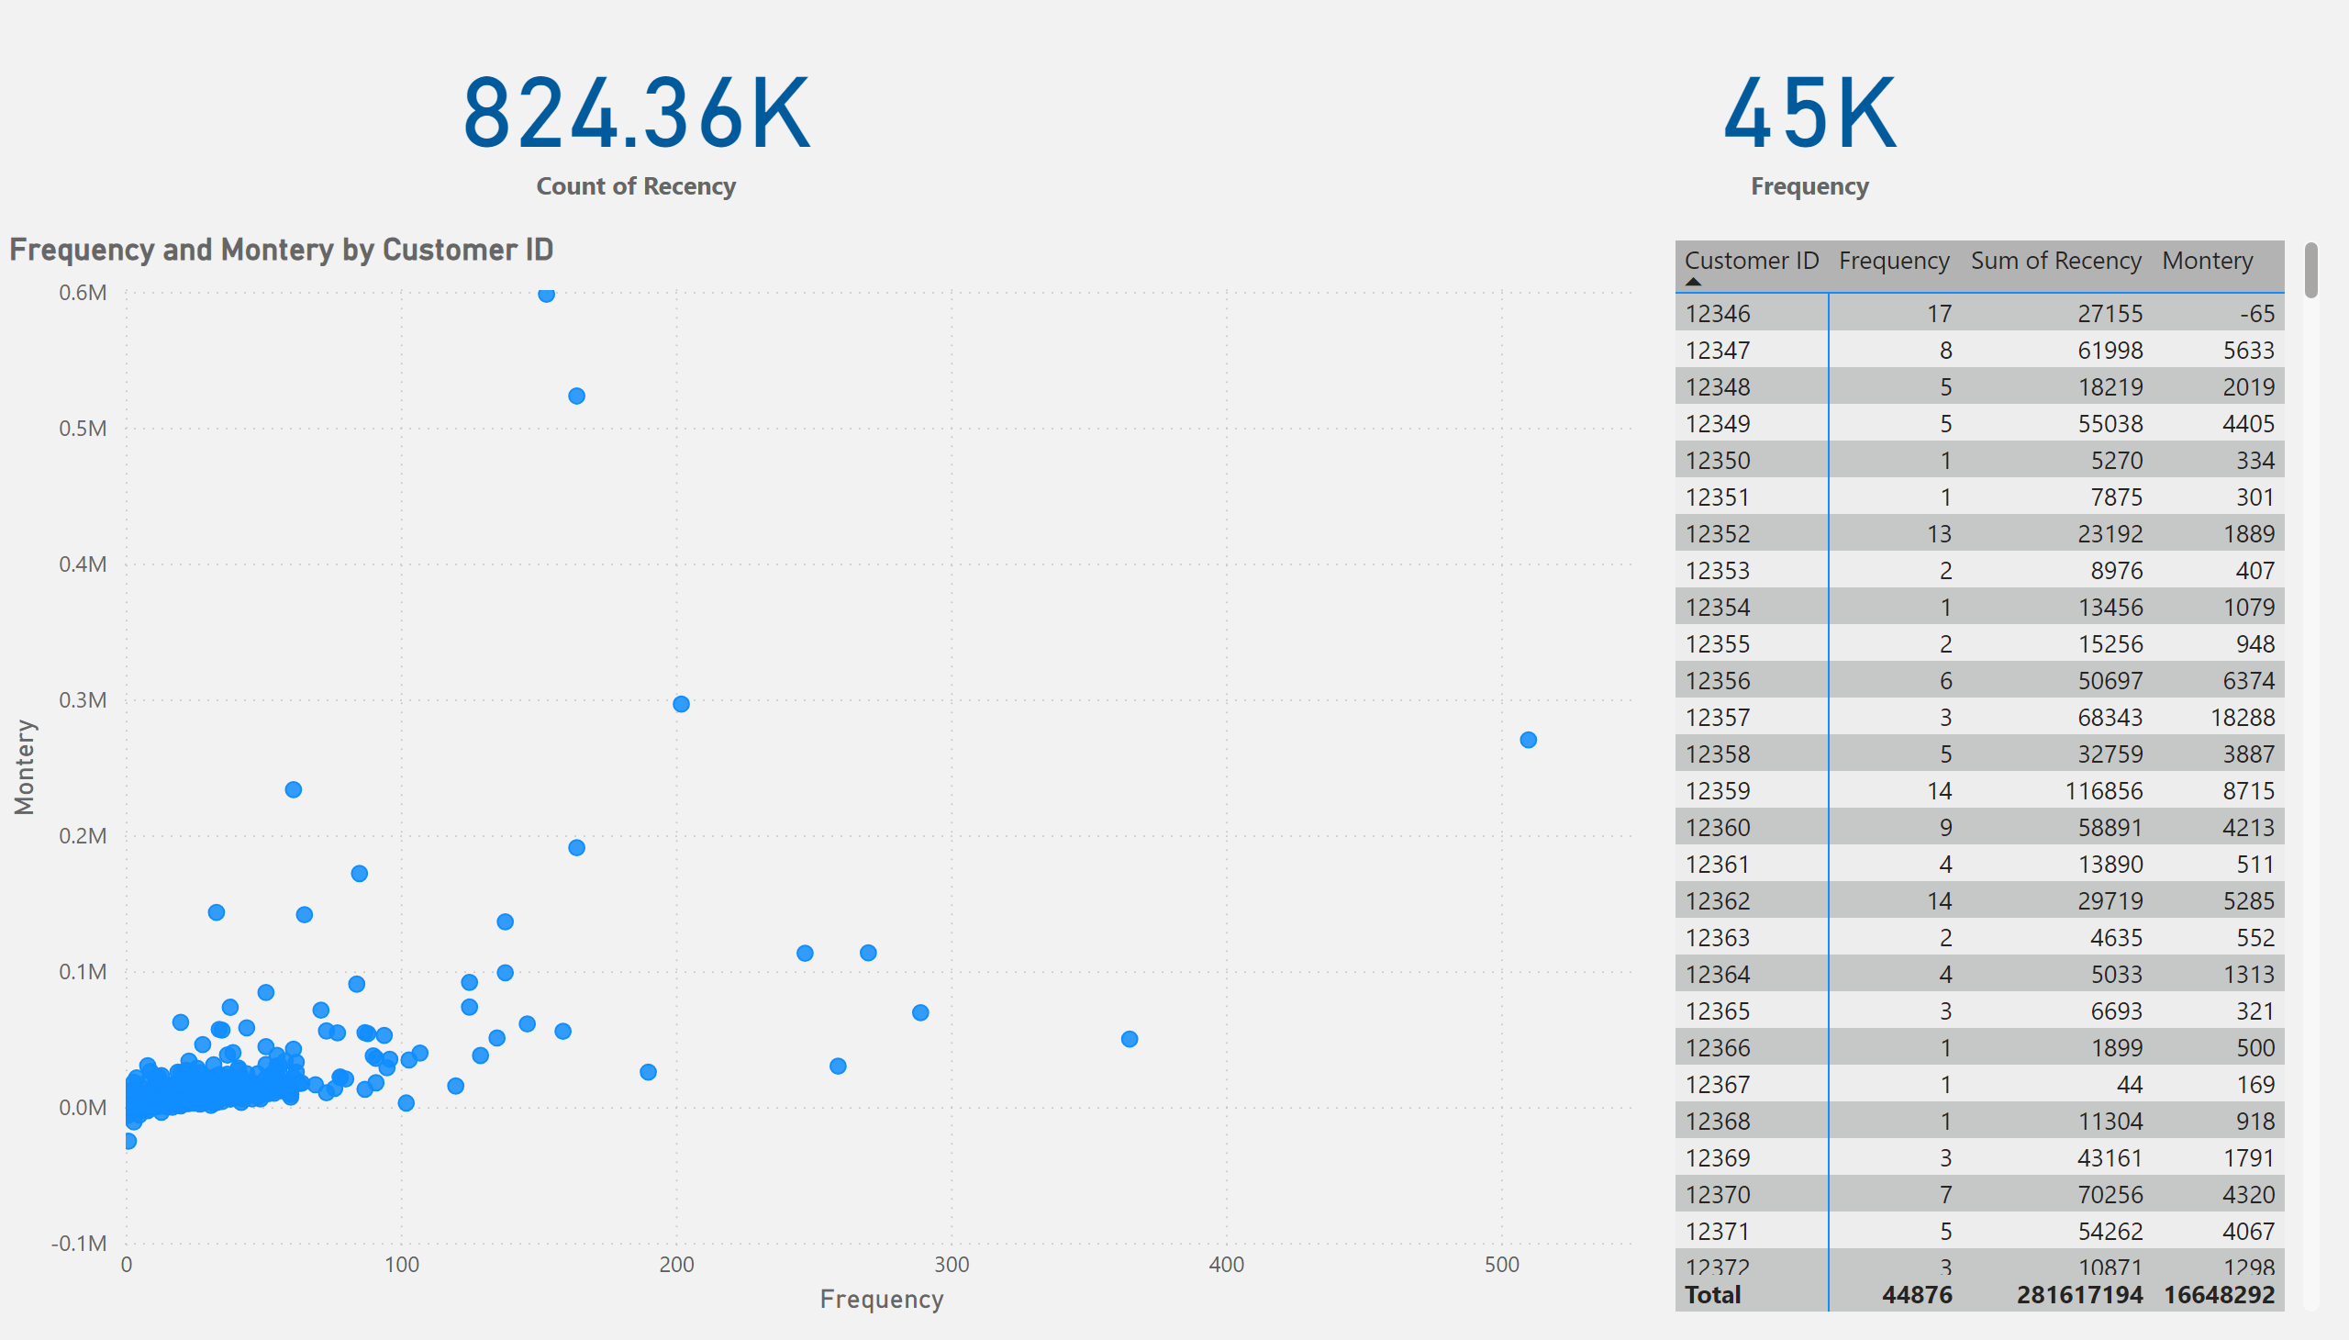
Page 1
Notes:
card
No alt text provided
card
No alt text provided
scatterChart
No alt text provided
pivotTable
No alt text provided

Slide 10

Sales Dashboard Highlights
This dashboard I designed displays a comprehensive analysis of sales, focusing on customer behaviour and financial performance. The dashboard's highlights can be divided into three main parts:
Financial Performance:
Customer Flow Factoring (RFM):.
Geographic Analysis:

Slide 11
Financial Performance:
Total Sales: The top number in the panel highlights total revenue, providing a quick overview of the business's volume.
Number of Customers: This number shows the size of the customer base, helping you understand the company's reach.
Average Sales: This shows the average value of each purchase, helping you assess whether customers tend to purchase higher-priced products.

Slide 12
Customer Flow Factoring (RFM):.
Monetary Value: Represented by the horizontal axis; the further to the right the dot, the more the customer has spent.
Frequency: Represented by the vertical axis; the higher the dot, the more frequently the customer purchases.
Recency: Represented by the size of the bubble; the larger the bubble, the more recent the customer is in the purchase process.
Together, these analyses highlight different customer segments, allowing you to identify:
Top Customers: The dots in the upper right of the chart represent customers who spend and buy frequently.
New Customers: The large bubbles in the upper left of the chart represent customers who spent a large amount on their last purchase.

Slide 13
Geographic Analysis:
The chart clearly shows how the company's performance is distributed geographically:
Country Sales: The map shows bubbles of different sizes, with the size of each bubble indicating the total sales in that country.
Major Markets: This map shows that the United Kingdom is the company’s largest market, indicating the importance of this market and the need to focus marketing efforts on it.

